Slide 1
Overview of programming and development

Slide 2
Programme and timeline
Name of the lesson | Number of hours
Overview of Programming and development | 24
Fundamentals of Databases and Dana Management | 8
Data Security and Privacy | 4
Basic Systems and Network Overview | 4
Web and Mobile Development Overview | 16
Software Development Life Cycle (SDLC) | 4

Slide 3
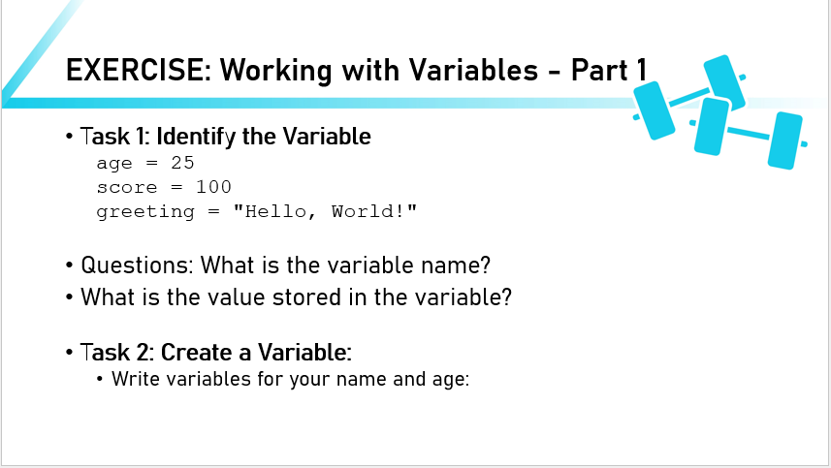
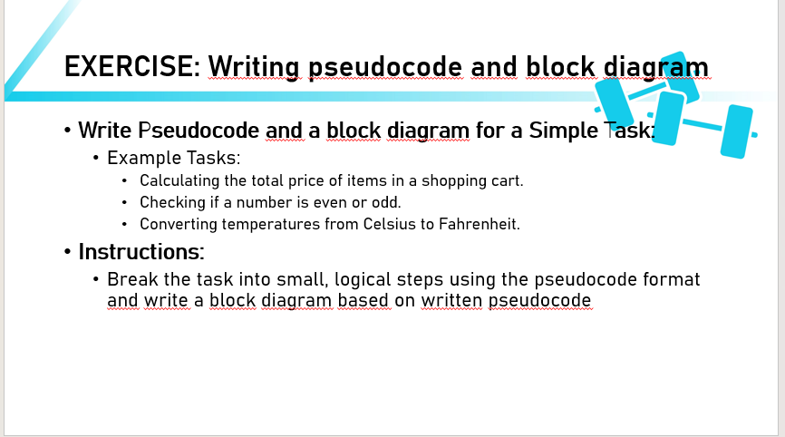
Introduction to Programming Concept – 4h
Objectives – Understand variables, data types, pseudocode and flowcharts.
Methods – Lecture, discussion, hands-on activity.

Slide 4
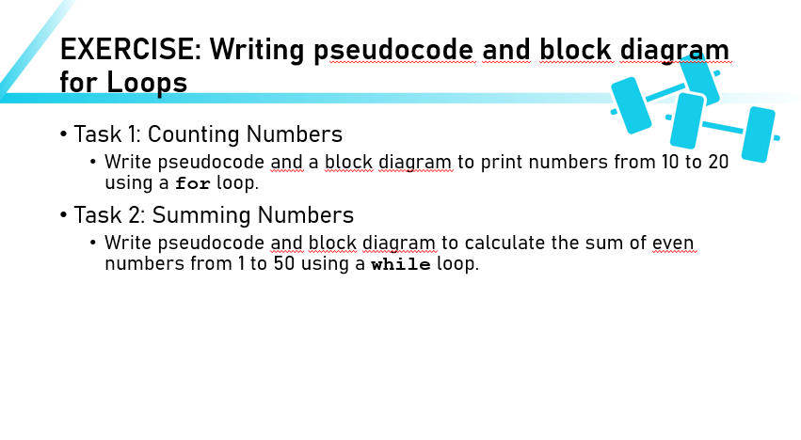
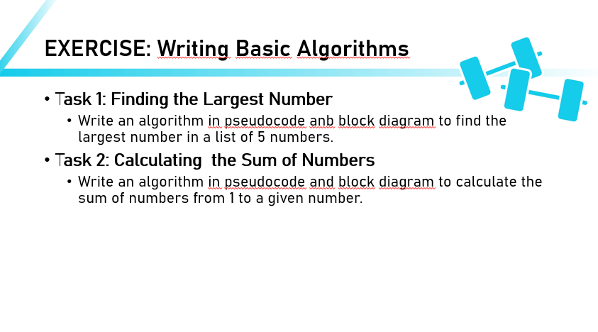
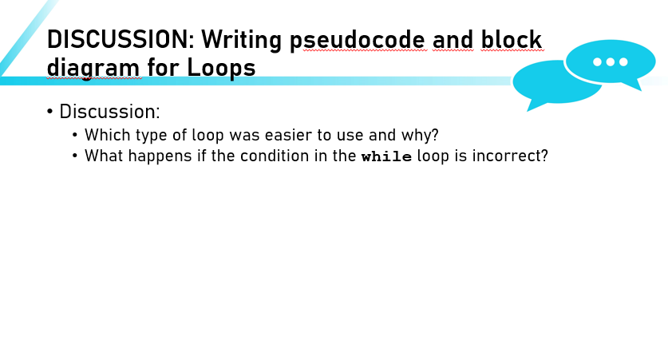

Slide 5
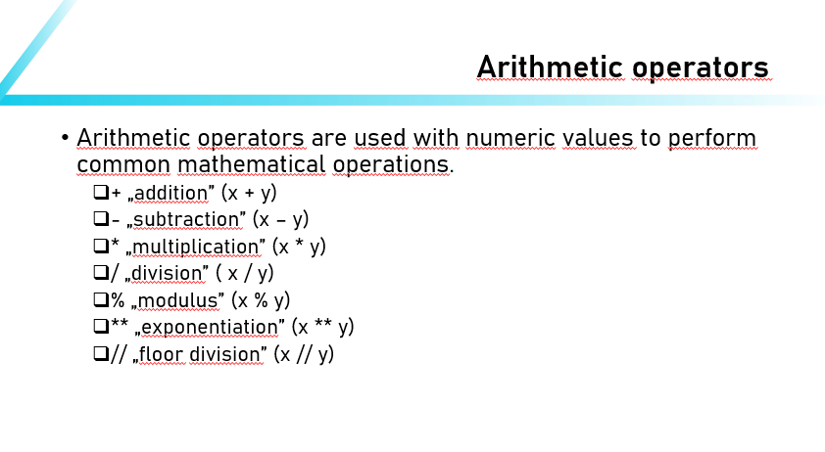
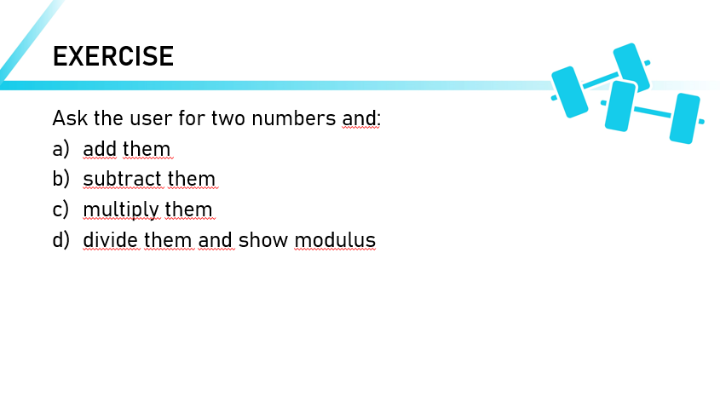
Python syntax and development setup – 2h
Objectives – Install python, set up and navigate VSC, write simple python scripts.
Methods – Lecture, hands-on activity

Slide 6
Use loops and conditional logic to build structured programs – 4h
Objectives – Ideftify different types of loops and conditional statements in python, implement loops to solve repetitive tasks and apply conditionals for decision-making.

Slide 7
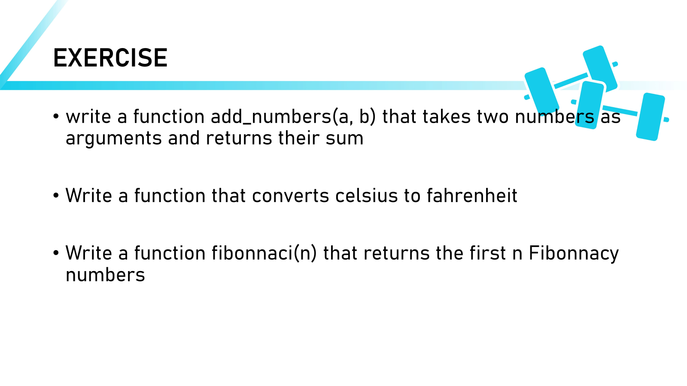
Develop reusable functions – 2h
Objectives – Define and structure functions in python, then implement them.

Slide 8
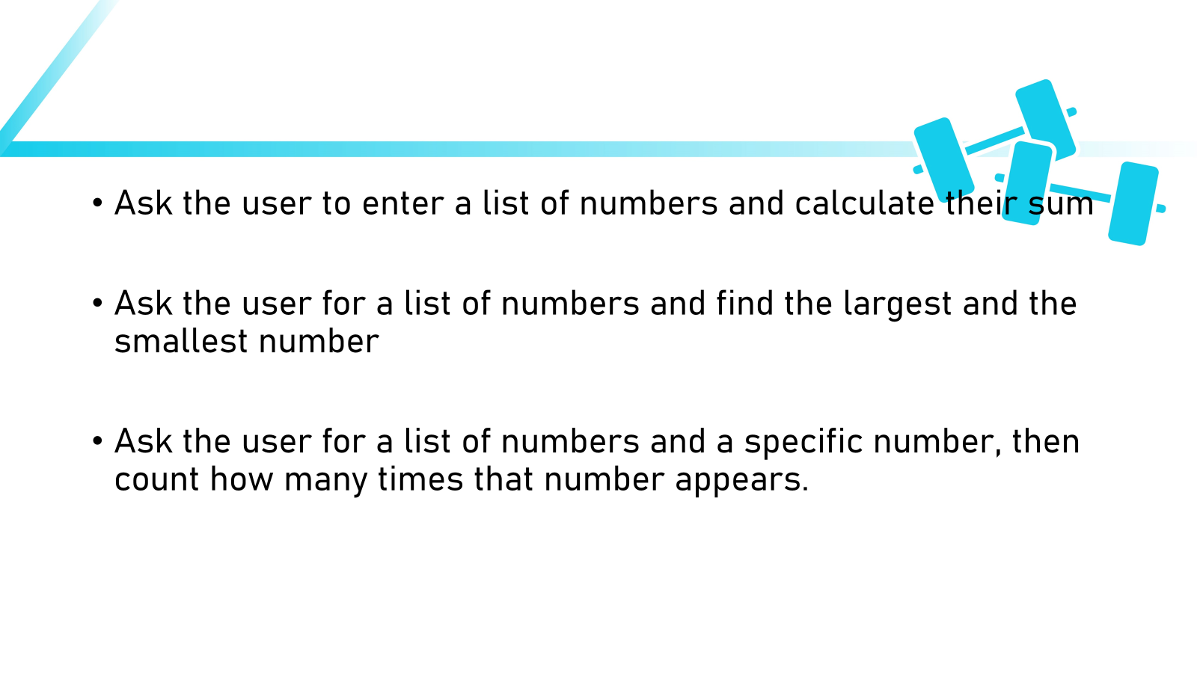
Python data structures – 4h
Objectives – Differentiate between lists, tuples, dictionaries and sets. Implement those dana structures to store organize and manage data.

Slide 9
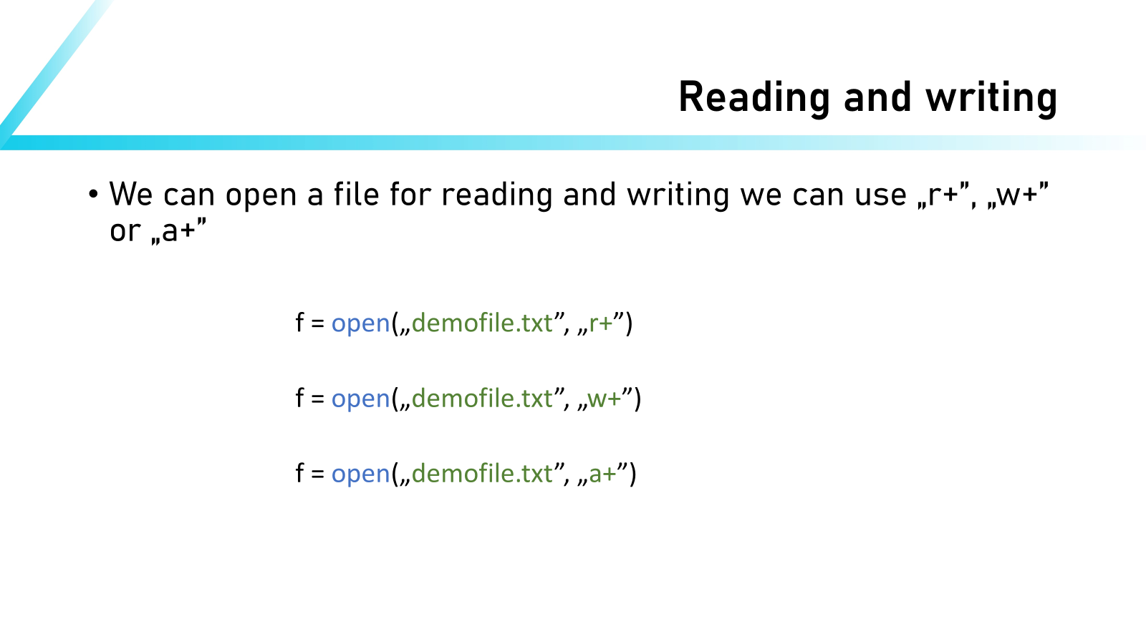
Manage data storage and retrieval with file handling – 2h
Objectives – understand the basics of reading and writing files in python.

Slide 10
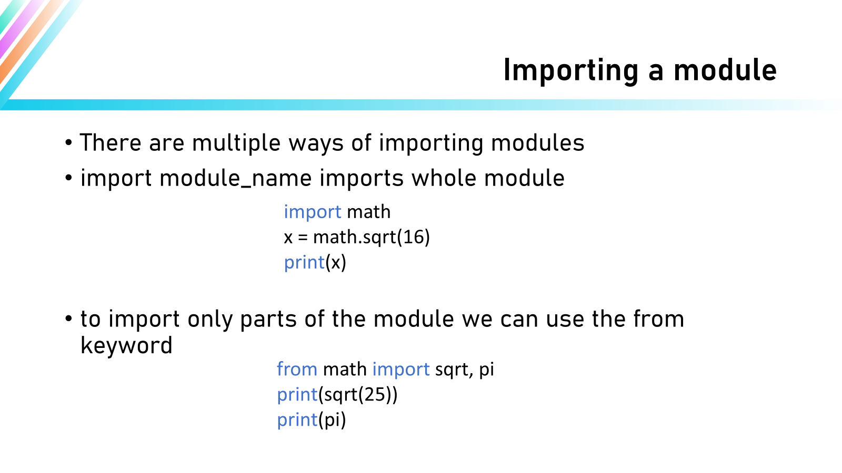
Enhance python projects with modules and packages – 2h
Objectives – Import and use modules to expand functionality.

Slide 11
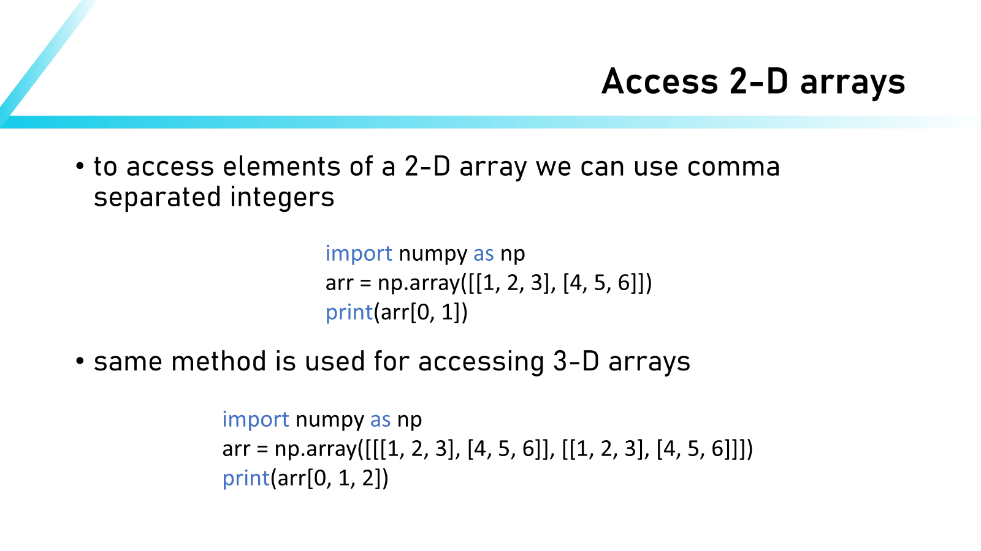
Perform data manipulation and numerical operations with numpy – 4h
Objectives – Use numpy for advanced calculations and multi dimensional arrays.

Slide 12
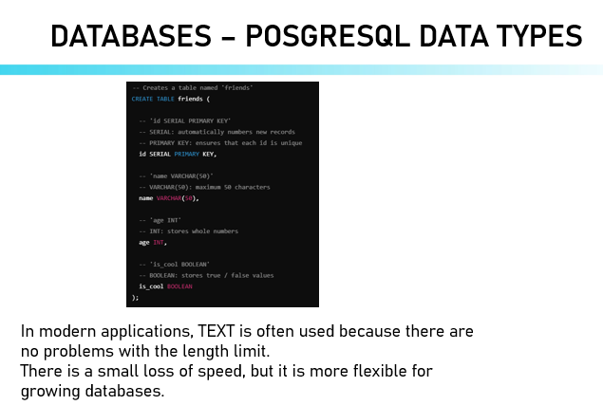
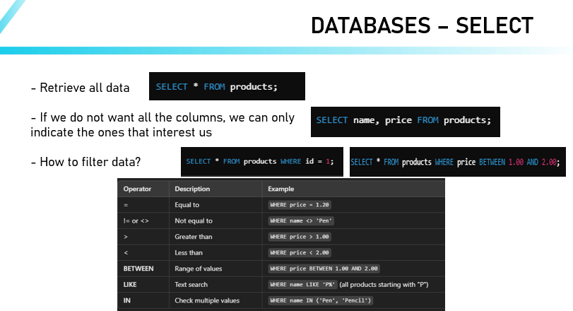
Understand the basics of relational databases and perform SQL operations – 4h
Objectives – Recognize the structure of relational databases and tables. Use SQL queries to retrieve, update and delete data.

Slide 13
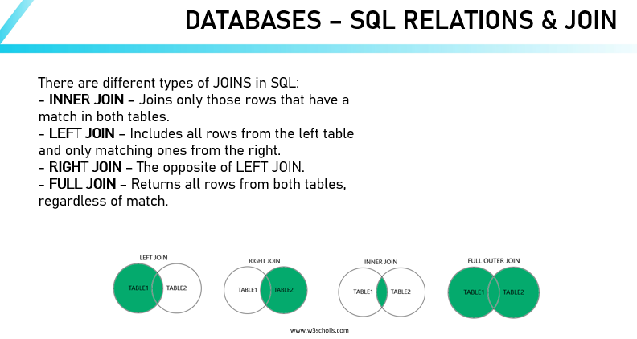
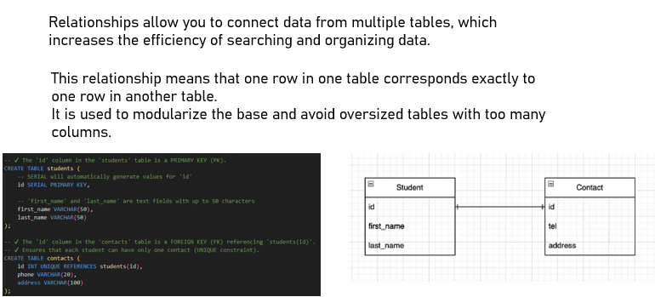
Develop dana models and optimize databases for efficient management – 4h
Objectives – Understand the role of conceptual, logical and physical data models. Create entity–relationship diagrams to represent data relationships.

Slide 14
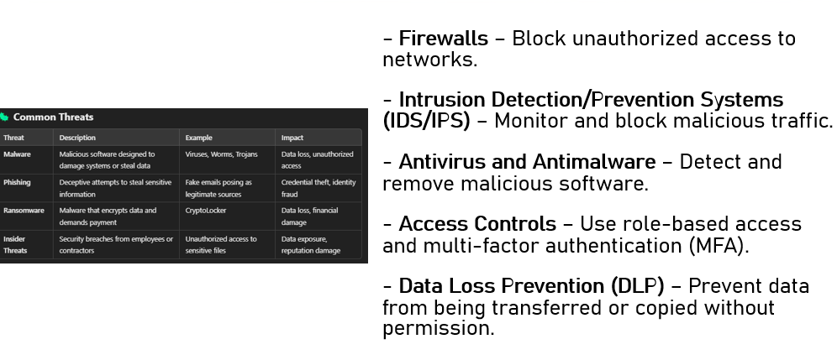
Recognize core data protection principles and implement security measures – 4h
Objectives - Identify common data security threats and methods for preventing unauthorized access.

Slide 15
Understand system architecture and networking concepts in IT – 4h
Objectives – Describe different architectural approaches and their impact on scalability. Recognize the role of IP addressing, network devices, and protocols.

Slide 16
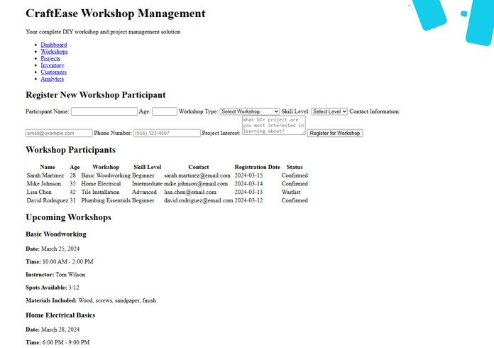
Structure and style basic web page using HTML – 4h
Objectives – Use HTMl tags to create heading, paragraphs, links and images. Write, validate, and structure HTML effectively.

Slide 17
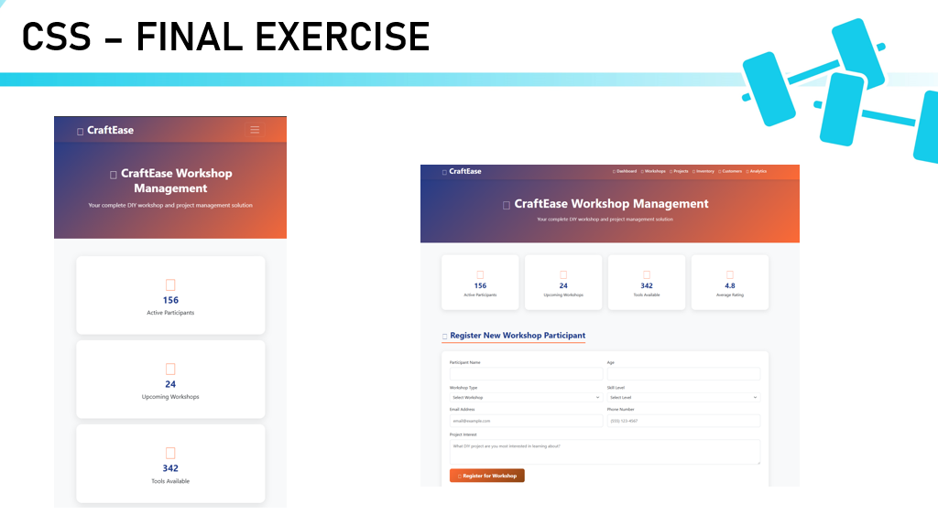
Design responsive layouts with advanced CSS – 4h
Objectives – implement the CSS box model, Flexbox, and Grid for layout.

Slide 18
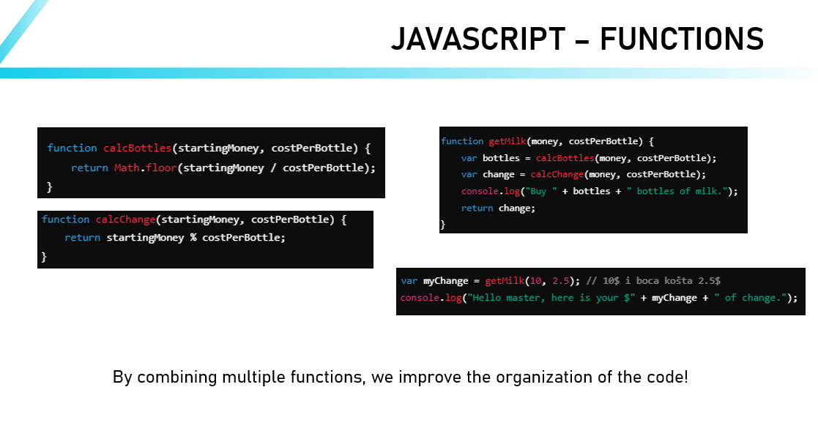
Add interactivity to web pages with JavaScript – 4h
Objectives - Understand JavaScript basics such as variables, functions, and events. Add interactive elements using event listeners.

Slide 19
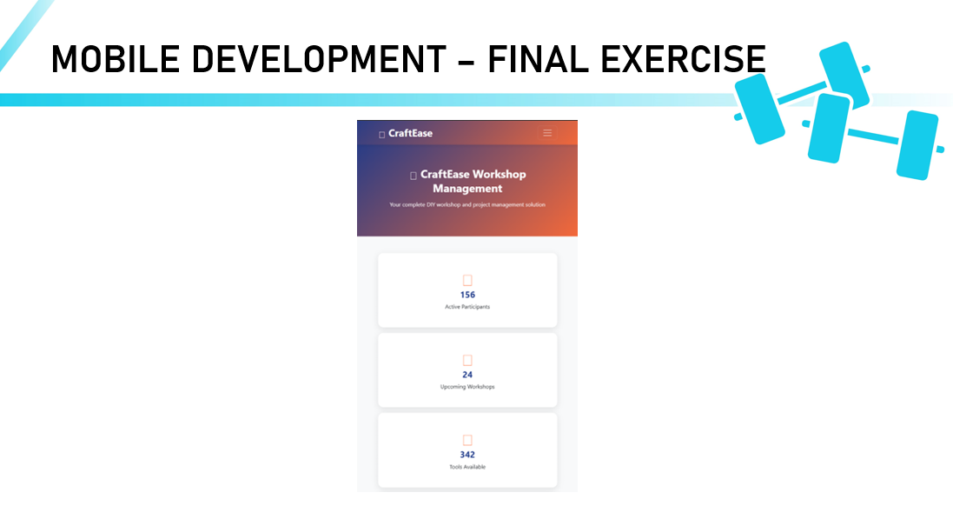
Develop and test a basic mobile app – 4h
Objectives – Get hands‑on experience packaging a simple web app into a mobile app with Cordova.

Slide 20
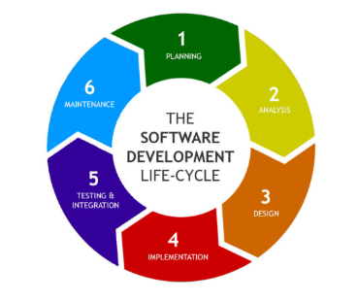
Outline and apply SDLC phases in project planing – 4h
Identify key SDLC phases and their objectives in software projects. Describe project manager roles and responsibilities with each phase.

